Slide 1
Writing and Submitting Student Learning Objectives
Dayton Public Schools
Notes:
Change Name as needed

Slide 2
TOPICS
Introduction to Student Growth Measures and Student Learning Objectives (SLOs)
Components of An SLO
Logistics of Submitting SLO in DPS Infonet
Deadlines and Setting Growth Measures
2
Notes:
Review 4 topics covered in the training

Slide 3
What are Student Learning Objectives?
Introduction
Introduction to Student Growth Measures and Student Learning Objectives (SLOs)
An SLO is:
A goal that demonstrates a teacher’s impact on student learning within a given interval of instruction.
A measurable, long-term academic target written by an individual teacher or a teacher team.

Slide 4
SLO Evaluation Cycle
SLO Development Process
SLO Approval
Midcourse
Check-In
Final Review of SLO Attainment and Scoring
Discussion of the Summative Rating and Impact on Practice
Notes:
Talk through the cycle of evaluation. They are here today to talk about the SLO development process, but beyond that discuss how SLO’s will be approved. It is recommended but not required that teachers complete a midcourse check-in. Teachers using the common formative assessments have those options. At the end of the interval of instruction, the teacher will pos-assess, analyze the data and score their SLO. After the SLO score is submitted, the evaluator and teacher should discuss their final summative rating in OTES and its impact on the teacher’s practice for the coming year.

Slide 5
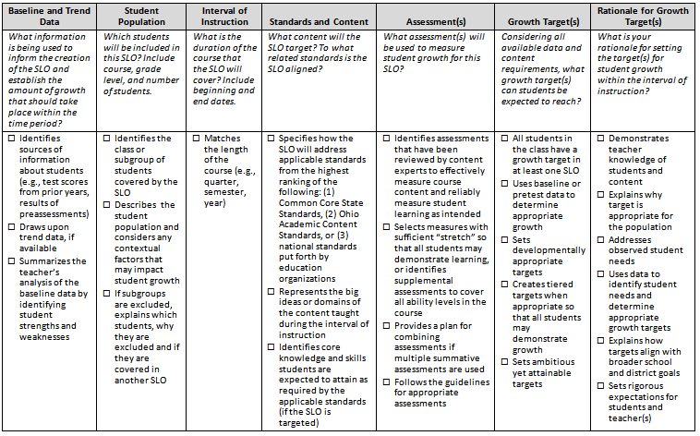
Components of a Student Learning Objective (SLO)
SLO Template Checklist
Notes:
This is the checklist that will be used to approve SLO’s. Just like a rubric that you give you stuents, use this while you are writing your SLO. The more you can show the approval committee that you are covering these topics, the more likely your SLO will be approved on the first submit.

Slide 6
High-quality SLOs include or address the following criteria:
Components
Baseline and Trend Data
Student Population
Interval of Instruction
Standards and Content
Assessment(s)
Growth Target(s)
Rationale for Growth Target(s)
6
Notes:
These are the seven components of an SLO. We will look at each criteria individually in the next few slides.

Slide 7
Student Population
Components
Include the following:
Students (all)
Course
Grade level
Number of students included in the objective
Contextual factors that may impact student growth.
Notes:
Read the checkboxes for student populations, show an example of how a teacher covers the text boxes.

Slide 8
Interval of Instruction
Components
Should match the duration of the course
August – March, unless block or semester

Slide 9
Standards and Content
Components
SLO should cover the content, skills, and specific standards to which the SLO is aligned.
Map tested standards are found under the SLO Process tab. Cut and paste the appropriate grade level band into the standards and content section.
Those SLO’s that do not use MAP can find the content and specific standards in the SLO Process folder contained in Curriculum and Instructional Guides on the Infonet. If your content area SLO standards are not in the Curriculum and Instructional Guides, create a support request at the bottom of the online SLO page.
Teachers should cut and paste the information for their subject area and/or grade level into the appropriate section on the SLO form.

Slide 10
Assessment(s)
Components
MAP is the assessment used for grades K-8 in ELA and math.
Other content assessments are contained in the Curriculum and Instruction Guide SLO folder. Click on the subject area and the pre and post assessments will be there. Teachers should use these assessments for SLO purposes.
If your content area SLO pre and post assessments are not in the Curriculum and Instructional Guides, create a support request at the bottom of the online SLO page.

Slide 11
Growth Target(s)
Components
Growth targets have been designed to allow for fairness and consistency while expecting rigor for student learning.

Slide 12
Growth Targets
Components
Growth targets will be put into the online form by October 28.

Slide 13
Logistics of Submitting SLO in DPS Infonet
Teachers must use the Dayton Public Schools Student Learning Objective Application online in the Infonet.
Teachers should use this template to submit all required components of their student learning objective.
NOTE: If you do not submit your SLO in this application it will not be evaluated or approved.

Slide 14
Logistics
How To Access The Application
Open up your web browser (Internet Explorer, Firefox, etc). The DPS Homepage should open.
Click on the DPS Infonet link.
Login with DPS username and password.
Click “District Web-Based Applications” and it will expand to show links to several applications.
Select “Student Learning Objectives” and click on the link. This will open the SLO application in a new window. Your screen will look similar to this:

Slide 15
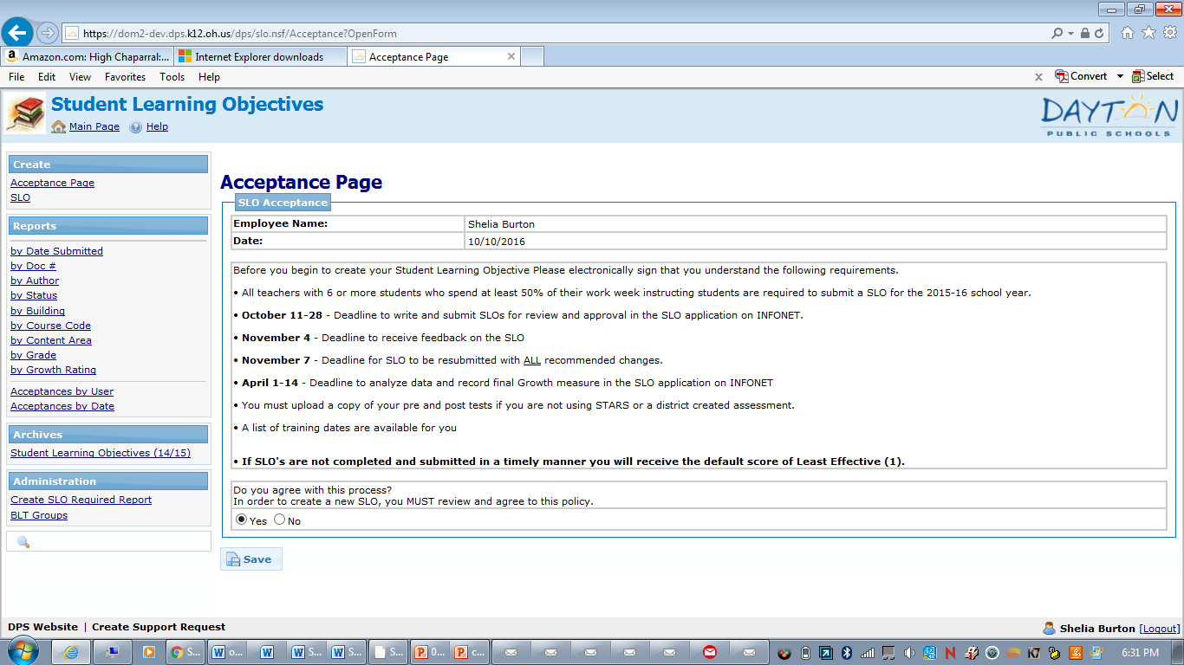
Logistics
You must accept the terms and conditions before proceeding.

Slide 16
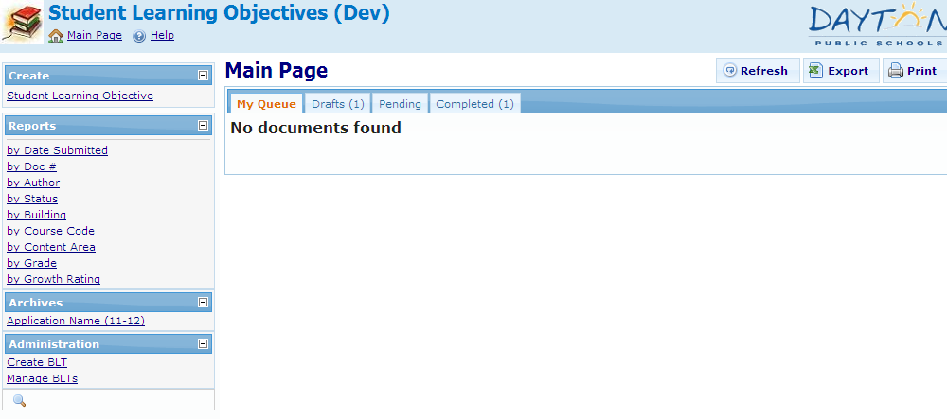
Logistics
Creating a New SLO
To create a new SLO, click on the “Student Learning Objective” link in the left hand frame, in the “Create” section

Slide 17
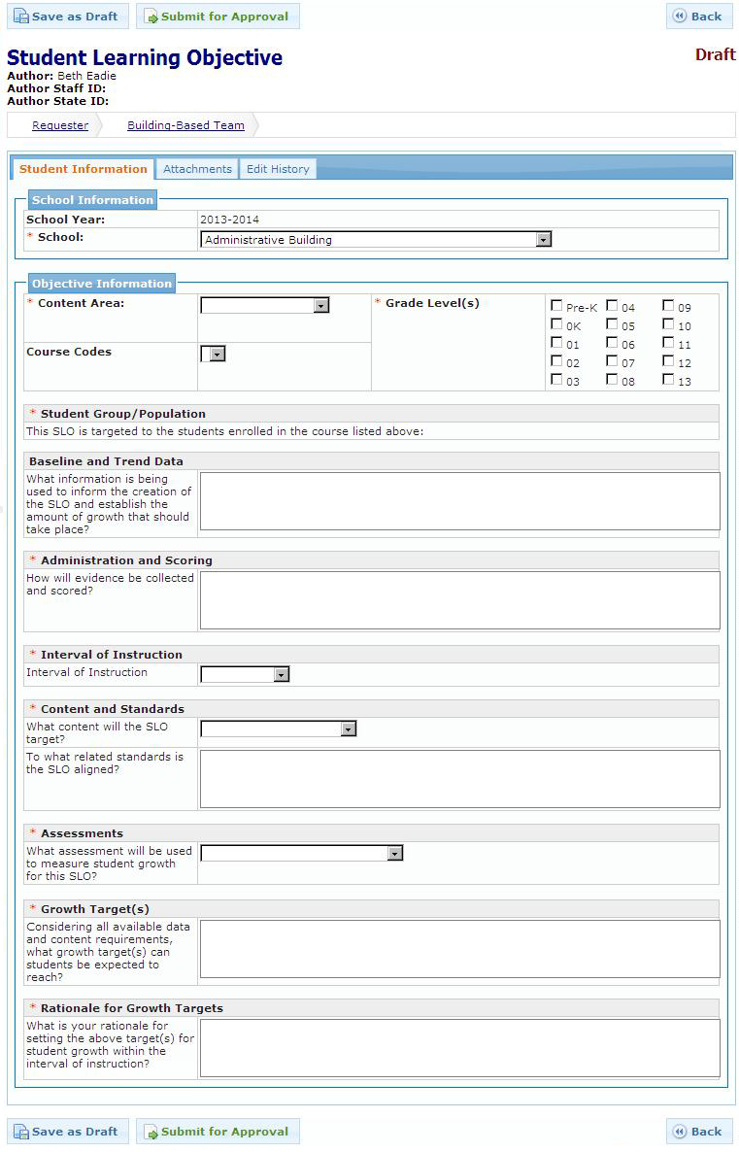
Logistics
An SLO template will open up. Complete each of the SLO components by filling in the required sections of the template.

Slide 18
MAP DATA
Logistics
For those using MAP, please attach the “Class Report” from MAP.
You will also attach the final report when completing the SLO in April with your analysis.

Slide 19
Logistics
When you complete your pre assessments you need to complete an SLO Scoring Template. You will enter each of your students pre assessment scores on this spreadsheet if you did a pre/post test process. You will also calculate their growth target based on the district formula and enter it

Slide 20
Logistics
Once you are sure that you have included all information and have attached required documents, hit the submit button. The Building Leadership Team will review the SLO and recommend approval or return it to you for revisions.
Save As Draft/Submitting an SLO
If you are working on an SLO and it is not ready for submission, click on the “Save as Draft” button. This will save for your SLO in “Draft” status. You can find these forms on the Main Page, in the “Drafts” tab.
Once your SLO is complete and ready for submission, click on the “Submit for Review and Approval” button. It will be routed to the next level of approval. An email will go out to the approver(s) letting them know that a form is waiting for their review and approval.

Slide 21
Logistics
If your initial SLO is disapproved, do not panic.
The BLT will complete the ODE rubric and will indicate specifically what needs to be corrected. When you resubmit with requested changes the SLO will be reviewed again.

Slide 22
Timeline for SLO Implementation 2016-17 and Beyond
Deadlines and Setting Growth Measures
October 11- 28 Deadline to write and submit SLOs for review and approval in the SLO application on INFONET.
November 4 – Deadline to receive feedback on the SLO.
November 7– Deadline for SLO’s to be resubmitted with ALL recommended changes.
November 14 – All SLO’s must be approved
November 15- All SLO’s implemented.
April 1- April 14 – Deadline to analyze data and record final Growth measure in the SLO application on INFONET
Note: If SLO’s are not completed and submitted in a timely manner you will receive the default score of Least Effective (1).
Also, make sure your data is correct before recording the growth measure. You will not be able to change the information.

Slide 23
Growth
Based on the Rating Scale below, your SLO will be rated
“Above,” “Met,” or “Below.”
This final step will finish the SLO process, marking the status of your SLO as “Complete”.

Slide 24
Further Questions
For questions or additional support, please Contact Theodore Oldiges, Instruction Support Specialist, Curriculum and Instruction by selecting the Create Support Request located at the bottom of the SLO page in the online application.
tjoldige@dps.k12.oh.us

